Slide 1
Sprint 4
Documentation and diagnostic plots

Slide 2
Agenda
Documentation
Diagnostic plots (outliers)
Air pressure: clean a-priori data
Universal data loading
Geotech data
Comparison outlier detection: v0.04 vs. tsoutliers
Next steps

Slide 3
Documentation
Vignette

Slide 4
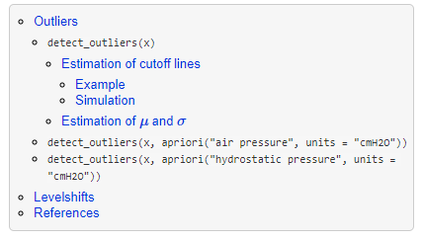
Documentation
Vignette TOC
2 main parts:
Vignette
API interface
Goal: pkgdown-like documentation
Website-like documentation
Supported by github

Slide 5
Diagnostic plots
Outliers

Slide 6
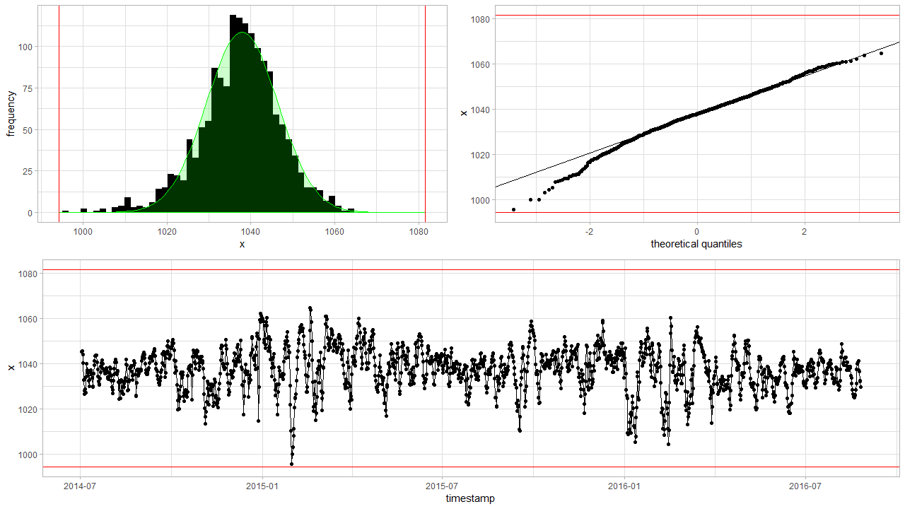
Diagnostic plots detect_outliers(x, plot = TRUE)

Slide 7
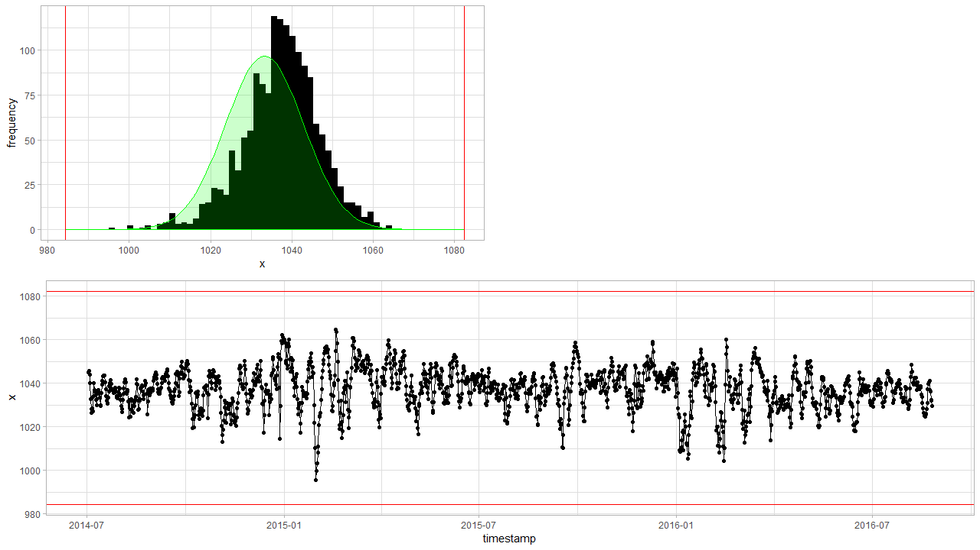
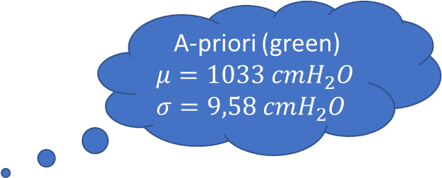
Diagnostic plots detect_outliers(x, apriori(“air pressure”) , plot = TRUE)
A-priori (green)
$$μ=1033 cmH_{2}O$$
$$σ=9,58 cmH_{2}O$$
Notes:
Based on new data

Slide 8
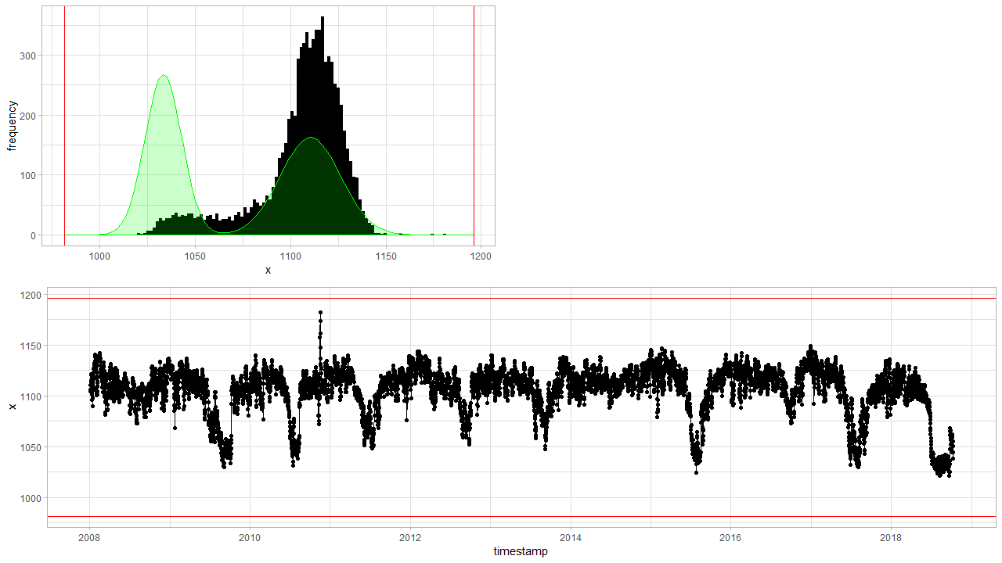
Diagnostic plots detect_outliers(x, apriori(“hydrostatic pressure”) , plot = TRUE)
Notes:
Based on new data

Slide 9
Air pressure
Clean a-priori data

Slide 10
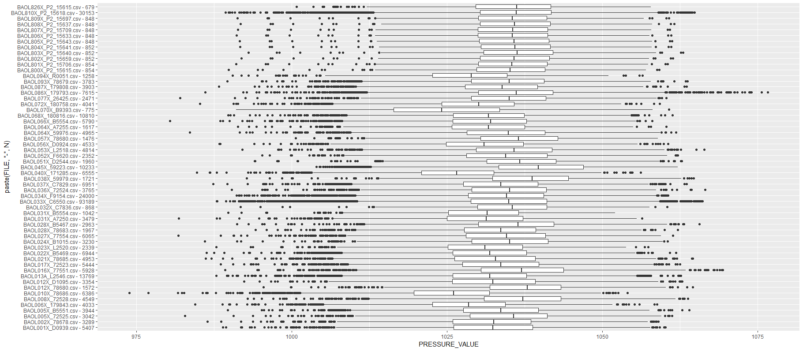
Air pressure: clean a-priori data
Notes:
Aggregated by day --> Some data is is high frequency (like BAOL033X) which has 20x or more datapoints than others, and thus has a higher weight on the distribution.
Are BAOL040X and BAOL010X and BAOL094X from the same region? And BAOL070X? This latter might be amplifying the left skewness.
Only data with a timestamp is taken into consideration.

Slide 11
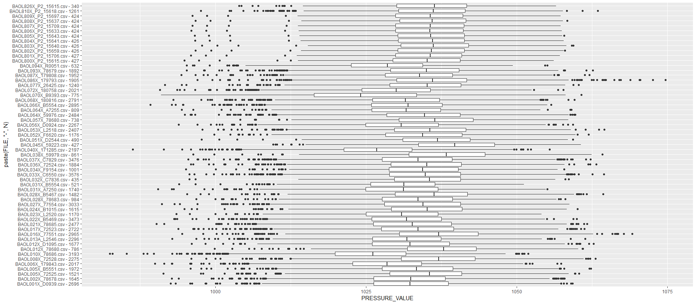
Air pressure: aggregated clean a-priori data

Slide 12
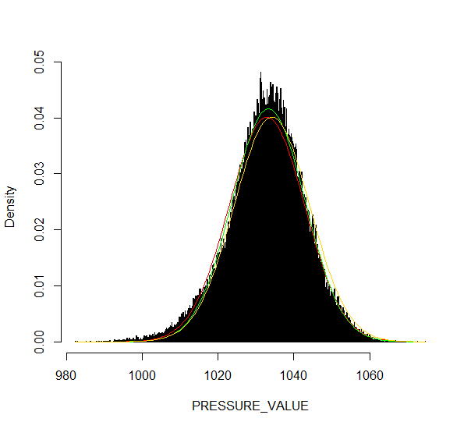
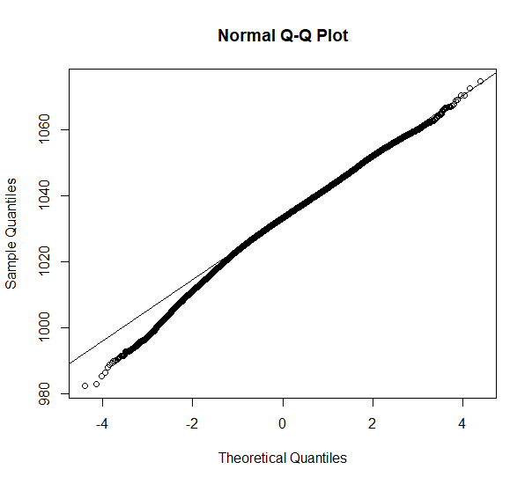
Comparison: apriori air pressure red (sd/mean), green (robust), yellow (robust old data)
A-priori pressure data is as good as it can get…
Notes:
The green curve s the robust estimate for in v0.02 (mean = 1033.317 // sd = 9.586297). The yellow one is the old estimate (1034.2 // 9.93342).

Slide 13
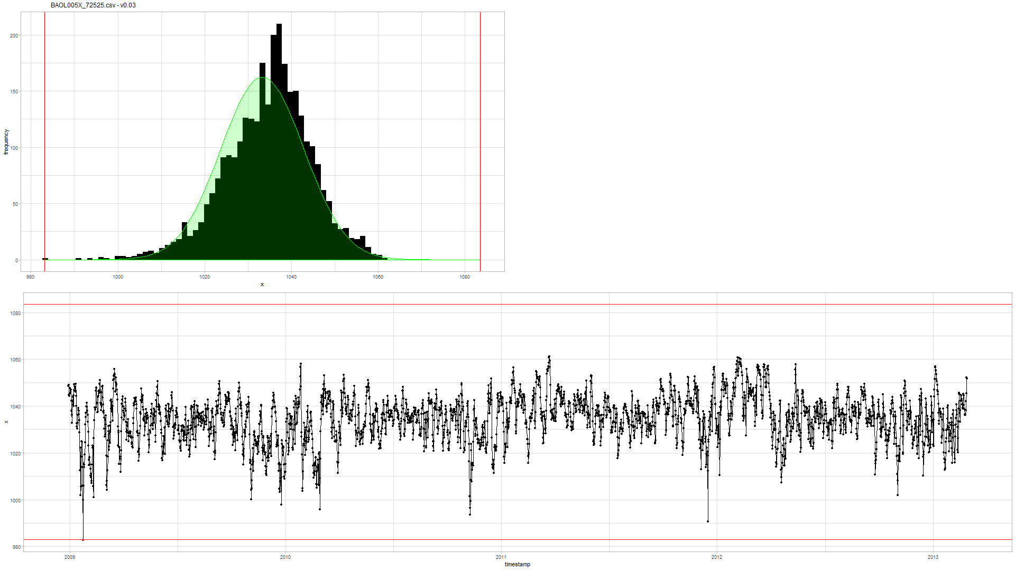

Example (BAOL005X_72525) v0.03 (new) vs. v0.02 (old)
Notes:
Rechts: oude v0.02: eerste punt is geen outlier
Links: nieuwe v0.03: is outlier

Slide 14
Logger
Universal data loading

Slide 15
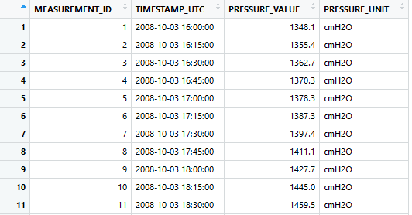
Uniform data loading: Logger object
Todo… VMM.
Static methods:
Logger::enumerate(partner = 'inbo')
Logger::enumerate(partner = 'geotech’)
Initialization:
df <- Logger('DYLP006X')$df
df <- Logger('ff_b29d_0903')$df
Uniform dataframe:
Primary key: MEASUREMENT_ID
UTC timestamp: TIMESTAMP_UTC
Value: PRESSURE_VALUE
Units: PRESSURE_UNIT
Notes:
Bedoeling is dat hier ook VMM data op een gelijkaardige manier wordt geladen.

Slide 16
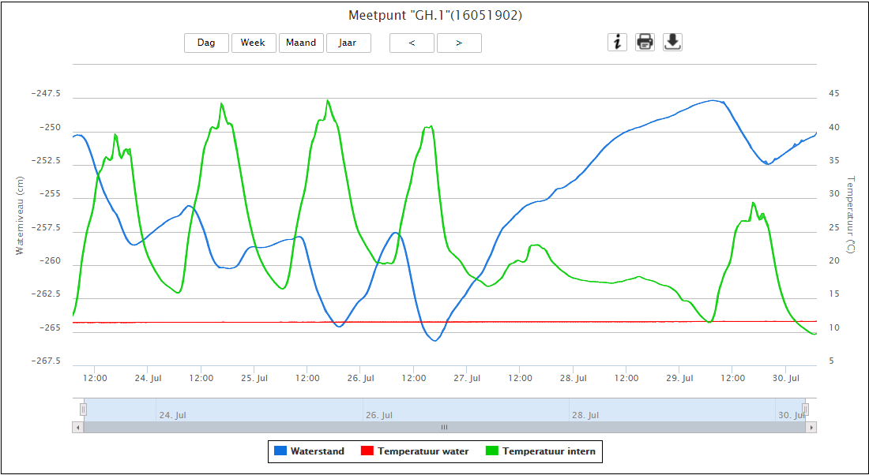
VMM raw data?
http://www.ellitrack.nl/tracker/

Slide 17
Geotechniek
Outliers

Slide 18
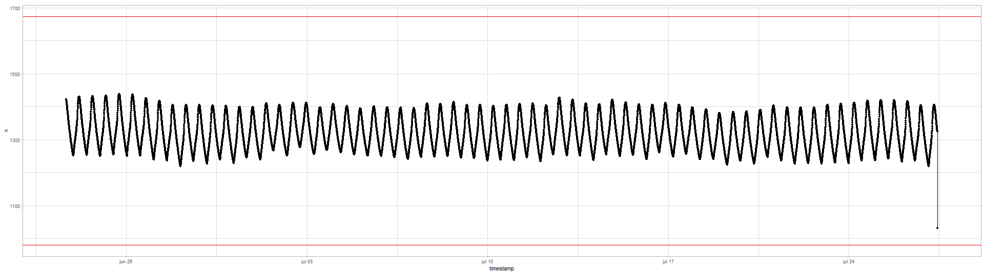
Quick exploration
All data have timestamps without NA
Time intervals are either 5 or 15min:
5 min 15 min 1307676 436567
If necessary: best to aggregate on hourly basis?
The data is clearly seasonal and a random walk

Slide 19
Geotech outlier comparison
Main comparison file:
https://github.com/DOV-Vlaanderen/groundwater-logger-validation/blob/levelshifts/src/r/outliers/outliers_comparison_geotech.pdf
5 methods
v0.01: normality assumption
v0.02: upper level = apriori air pressure, lower level normality assumption
v0.04: based on apriori difference min(left-diff, right-diff) knowledge:
5min: max 10cmH2O
tsoutliers:
Full: AO, TC, LS
AO only highlights with difference plot

Slide 20
tsoutliers --> AO
v0.01
v0.02
v0.04
tsoutliers --> AO, TC, LS

Slide 21
Geotech outlier comparison: v0.01
Data not normal but a seasonal random walk.

Slide 22
Geotech outlier comparison: v0.01
Sometimes it works, but mostly not…

Slide 23
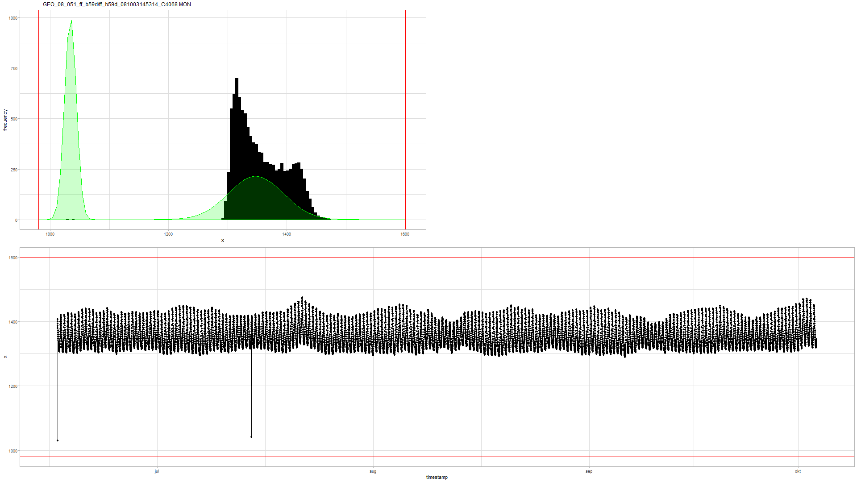
Geotech outlier comparison: v0.02
Similar to v0.01…

Slide 24
Geotech outlier comparison: v0.02
In the air…
“valid data”
Notes:
Voordeel is dus dat je gemakkelijk kan zien of de data wel “valid is” … maar daar stopt het wel.

Slide 25
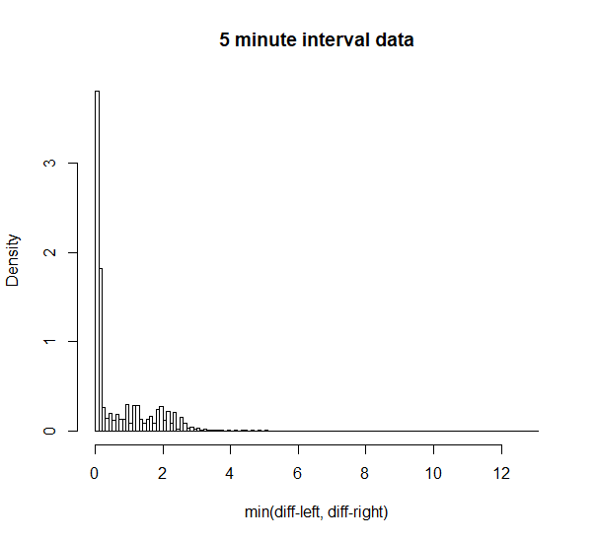
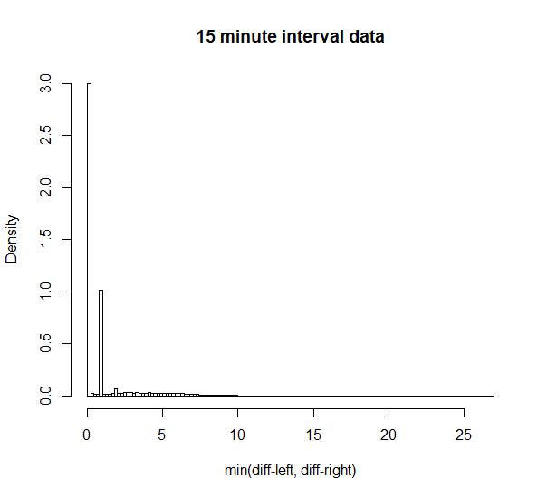
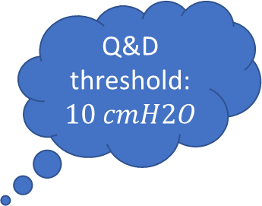

Geotech outlier comparison: v0.04
Q&D threshold: $10 cmH2O$
Q&D threshold: $30 cmH2O$
Notes:
Treshold: 10 and 30 cmH2O

Slide 26
Geotech outlier comparison: v0.04
Detected… (cf. v0.01 not detected)

Slide 27
Geotech outlier comparison: v0.04
Detected… (cf. v0.01 not detected)

Slide 28
Geotech outlier comparison: v0.04
Detected… (cf. tsoutliers not detected due to aggregation)

Slide 29
Geotech outlier comparison: v0.04
Detected… (cf. tsoutliers not detected due to last point or agg.)

Slide 30
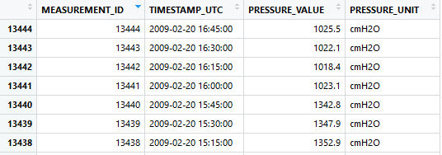
Geotech outlier comparison: v0.04
Missed due to multiple points. Level shift?

Slide 31
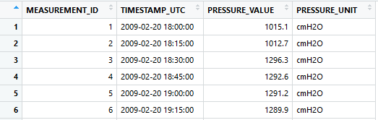
Geotech outlier comparison: v0.04
Also missed.
Level shift?

Slide 32
Geotech outlier comparison: tsoutliers
tsoutliers found it. Wrong point??

Slide 33
Geotech outlier comparison: tsoutliers
Weird… (v0.04 detects nothing)

Slide 34
tsoutliers detects two outliers? v0.04 nothing

Slide 35
Only v0.04 detected…

Slide 36
tsoutliers detects level shifts also…

Slide 37
tsoutliers aggregates: how to extract 1 single point.
Notes:
Omwille van aggregatie op uur ziet de tsoutlier plot er lichtjes anders uit.

Slide 38
Geotech outlier comparison: conclusion
v0.01 and v0.02
Normality assumption doesn’t apply to hydrostatic pressure.
v0.02 could be used to assess validity of data.
tsoutliers
Sometimes detects weird AO’s due to auto.arima model.
Slow: +10h on pp09-2_120829131517_F8511, pp08-2_120829135933_F8503, ff_b51d_090429160102_C4089
Aggregation required --> makes outlier detection and extraction of 1 point difficult.
Biggest strength is LS detection.
Personal note: we should be able to make something better.
v0.04
Is intelligible and fast.
Has no problems with first point and last point being outliers.
Is good in detecting 1 point outliers.
Has problems with > 1 point sequential outliers --> level shift?
Has best potential for outlier detection?

Slide 39
Level shifts: summary
Suggestion:
Reference algorithm (for comparison): tsoutliers
A custom approach…

Slide 40
Level shift?
Notes:
Omwille van aggregatie op uur ziet de tsoutlier plot er lichtjes anders uit.

Slide 41
No level shift?
Notes:
Omwille van aggregatie op uur ziet de tsoutlier plot er lichtjes anders uit.

Slide 42
Multiple level shifts?

Slide 43
Clear level shift.

Slide 44
Clear short level shift and outlier.

Slide 45
Next steps

Slide 46
Next steps
VMM data?
Focus on intelligible models vs. tsoutliers?
In case of outlier detection: you know “why”.
Improve and implement v0.04?
Level shifts
Improve tsoutliers (i.e. detect only large level shifts)
Make diagnostic plots for level shifts.
Custom approach…?

Slide 47
The End

Slide 48
Sprint 3
Level shifts

Slide 49
Agenda
Outliers
Level shifts
strucchange package
tsoutliers package
rank-based shift detection
Timestamps
Data aggregation
gwloggeR v0.1.2

Slide 50
Outliers
Recap

Slide 51
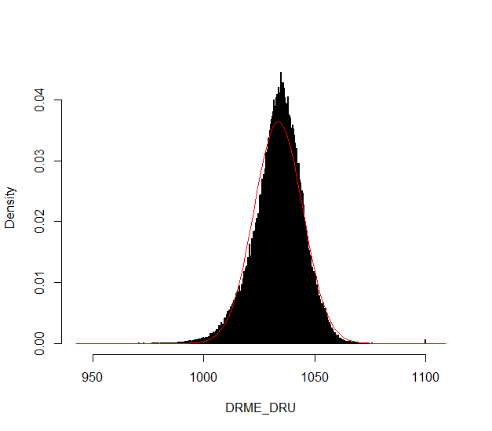
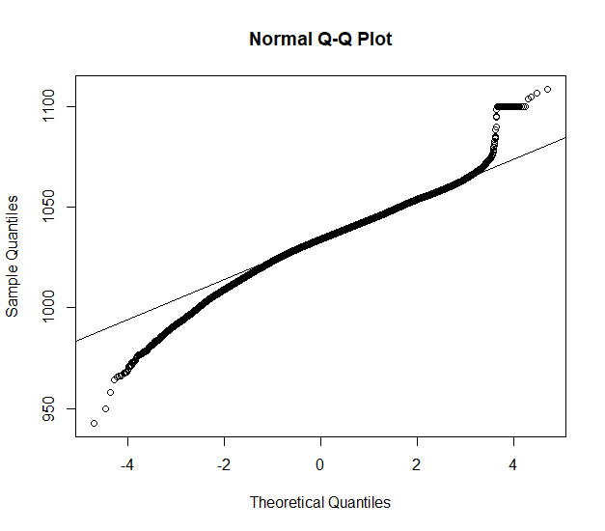
Outliers: v0.02
Validation
Excluded: BAOL089|BAOL079|BAOL006 (mBar)
Range: 800 < x < 1200
Notes:
Excluded: BAOL089|BAOL079|BAOL006
Range: 800 < x < 1200

Slide 52
Outliers: v0.02 example detect_outliers(x, apriori("air pressure", "cmH2O"))

Slide 53
Outliers: v0.02
Next steps
Build kernel based on clean data
Simulation test: verify power
Document in detail
Notes:
Excluded: BAOL089|BAOL079|BAOL006
Range: 800 < x < 1200

Slide 54
Level Shifts
strucchange
tsoutliers
rank-based

Slide 55
strucchange package
For modeling changes in mean

Slide 56
Level shift?

Slide 57
Strucchange package

Slide 58
Strucchange package
Pros:
Detects changes in a linear model (e.g. intercept only linear regression)
Mature package
Speed: 5 min average
Cons:
No ARIMA support
Uses lots of memory (+5GB on some cases)

Slide 59
tsoutliers package
For modeling level shifts with ARIMA models

Slide 60
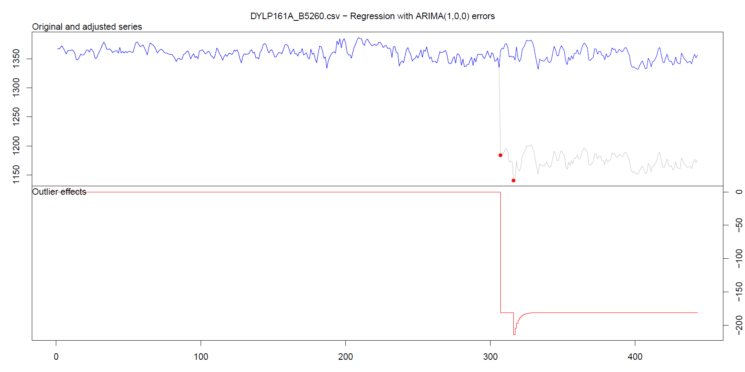
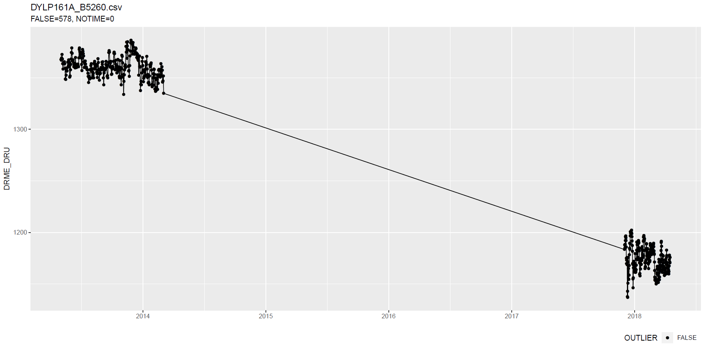
tsoutliers package
Notes:
Wat hier ook kan zijn, is dat intussentijd de situatie gewoon geleidelijk is gewijzigd: dus niet abrupt.

Slide 61
tsoutliers package
Notes:
Wat hier ook kan zijn, is dat intussentijd de situatie gewoon geleidelijk is gewijzigd: dus niet abrupt.

Slide 62
tsoutliers package
Notes:
Wat hier ook kan zijn, is dat intussentijd de situatie gewoon geleidelijk is gewijzigd: dus niet abrupt.

Slide 63
tsoutliers package
More cases: see here.

Slide 64
tsoutliers package
Pros:
Allows for a wide range of ARIMA-based models
Seems to detect LS well
Speed: 10 min average with aggregation
Cons:
Can not be used without aggregation (for >5k points)
Package is still in development

Slide 65
Rank-based shift detection
For modeling level shifts with rank-based statistics

Slide 66
Rank based level shift detection
Fried, R. e.a., On rank tests for shift detection in time series, 2007
Bovik, A.C. e.a., Nonparametric Tests for Edge Detection in Noise, 1986
Based on the distribution of a test statistic (e.g. Wilcoxon statistic) the normal situation can be defined. Based on this definition, exceptional shift situations could be detected.
Pro: speed!

Slide 67
Defining Level Shift
Discussion

Slide 68
Level shift?

Slide 69
Level shift?
Notes:
Lots of missing data!!

Slide 70
Level shift?
Notes:
Lots of missing data!!

Slide 71
Level shift?

Slide 72
Level shift?

Slide 73
Level shift?
Notes:
2 shifts?

Slide 74
Level shift?
Notes:
Is rood een flat line?

Slide 75
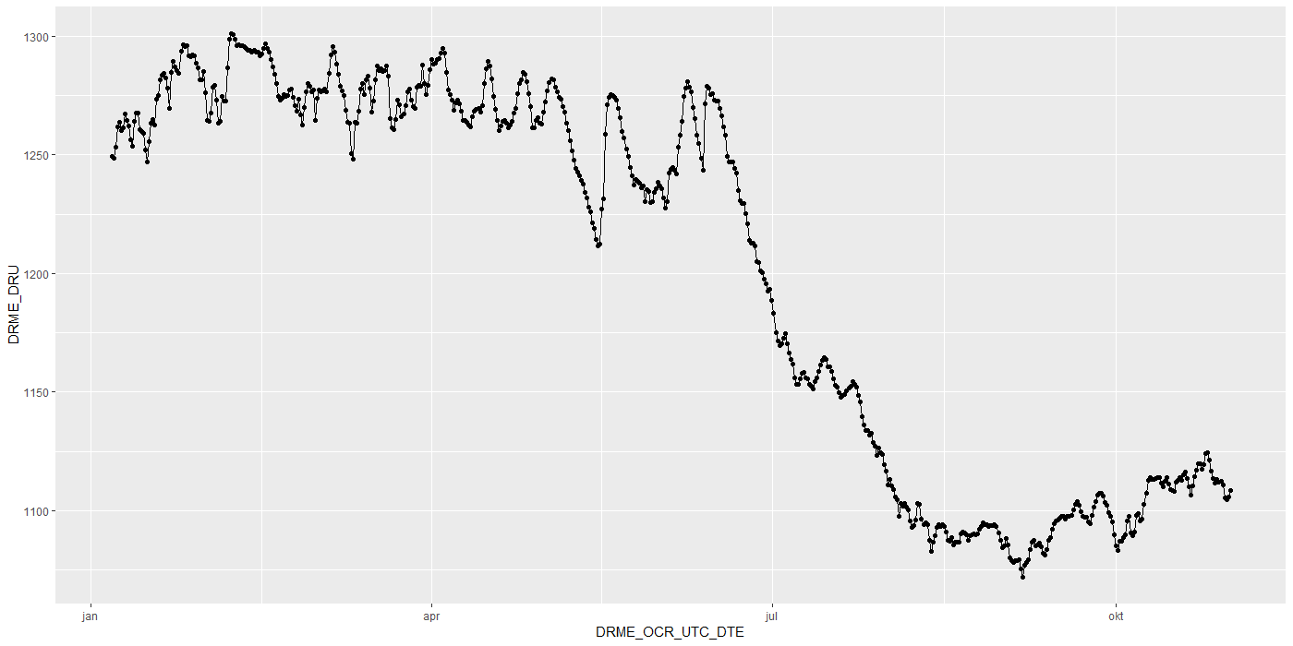
Level shift?

Slide 76
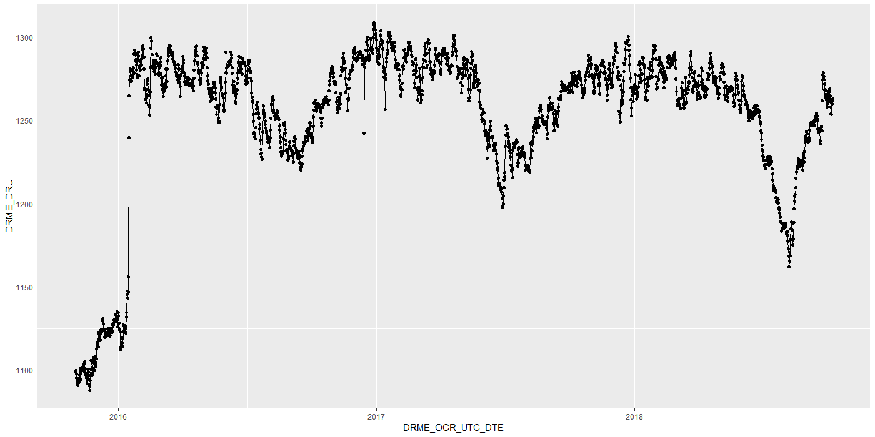
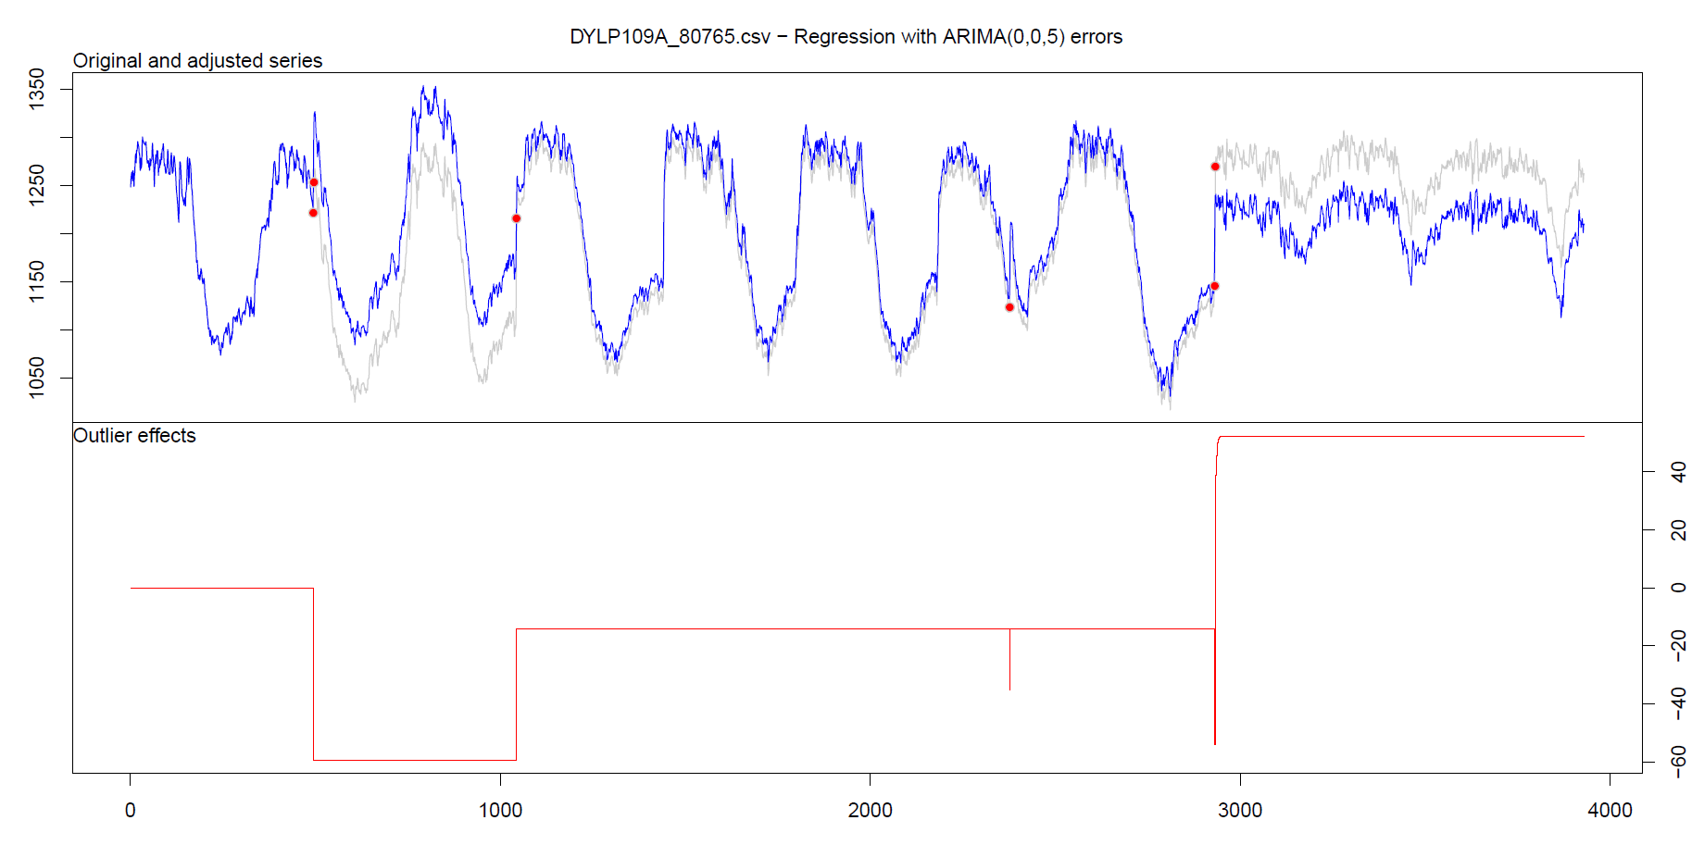
Level shift?

Slide 77
Level shift?

Slide 78
Level shift: tsoutliers

Slide 79
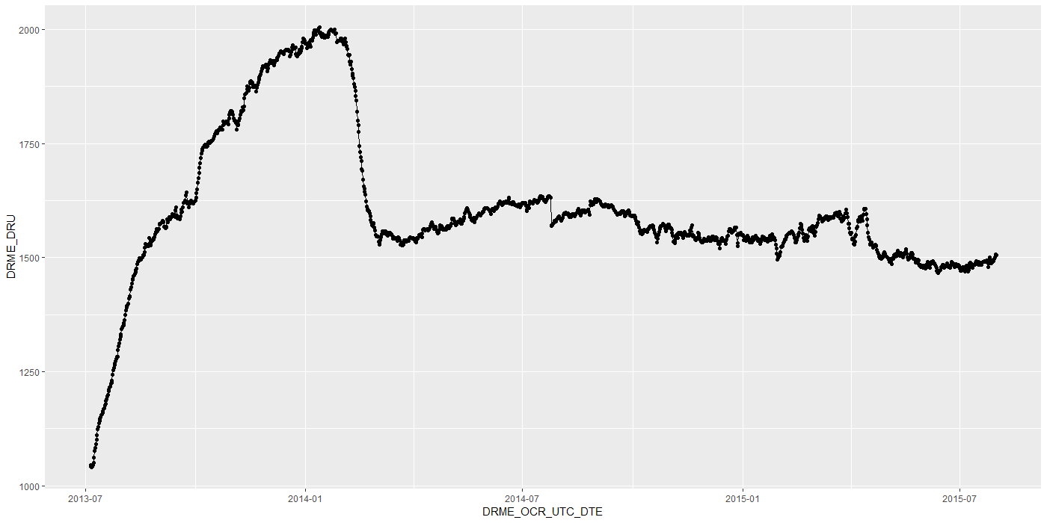
Level shift?
Notes:
Is rood een flat line?

Slide 80
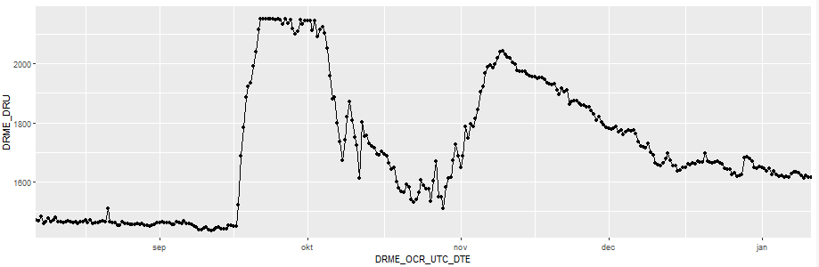
Level shift?
?
Notes:
Is rood een flat line?

Slide 81
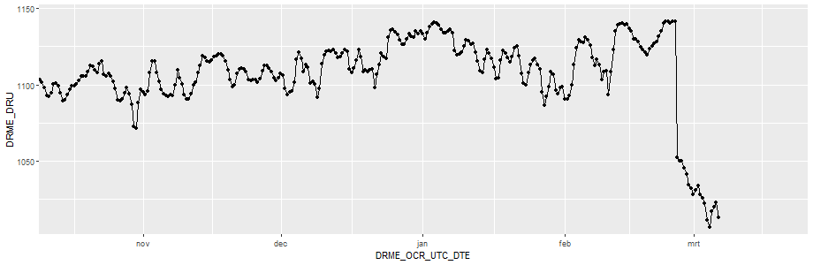
Level shift?
Notes:
Is rood een flat line?

Slide 82
Timestamps

Slide 83
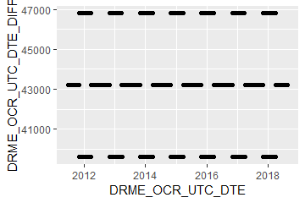
Timestamps: varying time-difference between observations (BAOL068X_180816.csv)
Sometimes 11, 12 or 13 hours
Notes:
BAOL068X_180816.csv

Slide 84
Timestamps: varying time-difference between observations
Equidistant observations are important for ARIMA-like timeseries models.
Without equidistance, the usability of ARIMA is limited.
Example: Differencing
For small time-differences: measured differences determined by sensor inaccuracy
For large time-differences: measured differences determined by sensor inaccuracy and atmospheric changes.
Timestamps: Take into account all kinds of scenarios?

Slide 85
Importance
Visualization:
Its either TIMESTAMP or SEQUENCE
INBO:
Can make sure that timestamp is always available.
Other parties?

Slide 86
gwloggeR
Change log
Feedback?

Slide 87
Change log
“Diver” → “hydrostatic pressure”
ap <- apriori("hydrostatic pressure", "cmH2O")
detect_outliers(x, apriori = ap)
detect_duplicates(ts)

Slide 88
Aggregation function
Lump together and take average.
Other (better?) ways?

Slide 89
Next steps

Slide 90
Next steps
Outliers v0.02
Build kernel based on clean data
Simulation test: verify power
Document in detail
Level shifts:
Gather more Level Shift examples
Better visualization
“Nederlanders”?

Slide 91
Hysteresis?

Slide 92
The End

Slide 93
Sprint 2
Outliers

Slide 94
Agenda
DRME_DMST_CDE validation
Outliers: v0.02 update
Comparison v0.01 vs v0.02
gwloggeR v0.1.1
Assessment
anomalize
tsoutliers

Slide 95
DRME_DMST_CDE
Flags from DB: ENT (entered); DEL (deleted) and INV (invalid).

Slide 96
DRME_DMST_CDE
On all *.csv-data:
DEL ENT INV VLD <NA>
462 556271 4697 16 0

Slide 97
DRME_DMST_CDE: VLD and DEL
PPNT_ID PPNT_CDE DRSO_ID DRSO_SER_NBR DRME_ID DRME_OCR_UTC_DTE DRME_DRU DRME_TPU DRME_DMTP_CDE DRME_DMST_CDE SEQUENCE
1: 7019 BAOL001X 275 D0939 238389 2010-11-11 10:00:00 1018.100 NA LDME VLD 1093
2: 7019 BAOL001X 275 D0939 1824560 2010-11-11 10:00:00 1018.075 6.033 LDME ENT 1130
3: 7019 BAOL001X 275 D0939 238390 2010-11-11 22:00:00 1007.300 NA LDME VLD 1094
4: 7019 BAOL001X 275 D0939 1824561 2010-11-11 22:00:00 1007.275 8.163 LDME ENT 1131
5: 7019 BAOL001X 275 D0939 238391 2010-11-12 10:00:00 1015.400 NA LDME VLD 1095
6: 7019 BAOL001X 275 D0939 1824562 2010-11-12 10:00:00 1015.375 11.213 LDME ENT 1132
7: 7019 BAOL001X 275 D0939 238392 2010-11-12 22:00:00 1012.900 NA LDME VLD 1096
8: 7019 BAOL001X 275 D0939 1824563 2010-11-12 22:00:00 1012.850 12.457 LDME ENT 1133
9: 7019 BAOL001X 275 D0939 238393 2010-11-13 10:00:00 1014.600 NA LDME VLD 1097
10: 7019 BAOL001X 275 D0939 1824564 2010-11-13 10:00:00 1014.600 10.810 LDME ENT 1134
11: 7019 BAOL001X 275 D0939 238394 2010-11-13 22:00:00 1012.700 NA LDME VLD 1098
12: 7019 BAOL001X 275 D0939 1824565 2010-11-13 22:00:00 1012.675 10.953 LDME ENT 1135
Duplicates: Detect those too?
Notes:
Duplicaten in de DB?

Slide 98
DRME_DMST_CDE: INV
Validation

Slide 99
DRME_DMST_CDE: INV
Validation

Slide 100
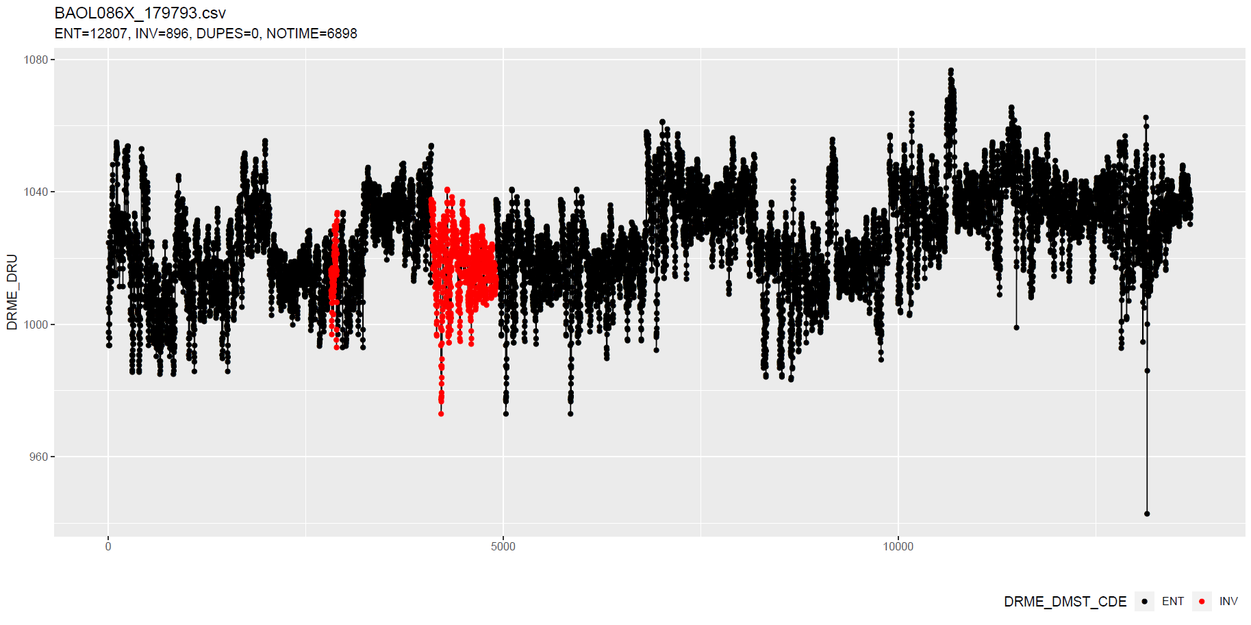
DRME_DMST_CDE: INV
Validation
No Timestamp (Inconsistent)
No Timestamp: Detect those too?
Notes:
Inconsistent because there are also black dots that have no timestamp.

Slide 101
Outliers: v0.02 update
Uses simple a-priori knowledge about air pressure, temperature, etc.

Slide 102
Outliers: v0.02 update
Validation
Excluded: BAOL089|BAOL079|BAOL006 (mBar)
Range: 800 < x < 1200
Notes:
Excluded: BAOL089|BAOL079|BAOL006
Range: 800 < x < 1200

Slide 103
Outlier comparison
v0.01, v0.02, DRME_DMST_CDE

Slide 104
Outlier comparison

Slide 105
Outlier comparison

Slide 106
Outlier comparison

Slide 107
Outlier comparison

Slide 108
Outlier comparison

Slide 109
Outlier comparison

Slide 110
Outlier comparison

Slide 111
Outlier comparison

Slide 112
tsoutliers package

Slide 113
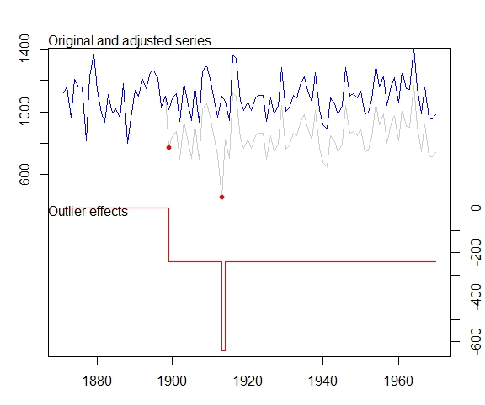
tsoutliers package
auto.arima(Nile)
Series: Nile
ARIMA(1,1,1)
Coefficients:
ar1 ma1
0.2544 -0.8741
s.e. 0.1194 0.0605
sigma^2 estimated as 19769: log likelihood=-630.63
AIC=1267.25 AICc=1267.51 BIC=1275.04
nile.outliers <- tso(Nile,types = c("AO","LS","TC"))
nile.outliers
Series: Nile
ARIMA(0,0,0) with non-zero mean
Coefficients:
intercept LS29 AO43
1097.7500 -242.2289 -399.5211
s.e. 22.6783 26.7793 120.8446
sigma^2 estimated as 14401: log likelihood=-620.65
AIC=1249.29 AICc=1249.71 BIC=1259.71
Outliers:
type ind time coefhat tstat
1 LS 29 1899 -242.2 -9.045
2 AO 43 1913 -399.5 -3.306
Notes:
https://stats.stackexchange.com/questions/104882/detecting-outliers-in-time-series-ls-ao-tc-using-tsoutliers-package-in-r-how

Slide 114
tsoutliers package: AO’s

Slide 115
tsoutliers package: AO’s

Slide 116
tsoutliers package: AO’s
WRONG
TIMESTAMPS NOT SEQUENTIAL
Notes:
Afstandedn veel groter sinds 2018

Slide 117
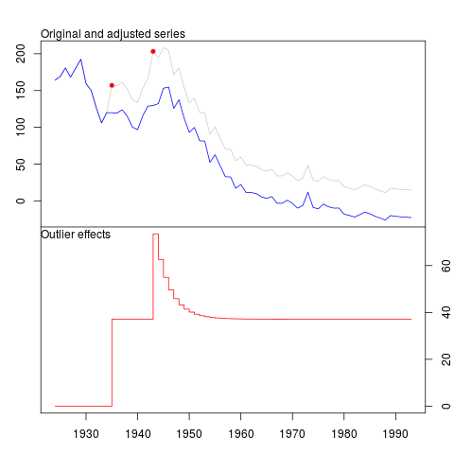
tsoutliers package
Pros:
Formalism
Integration with (S)ARIMA
Cons:
Speed? (+12h on BAOL033X_C6550.csv)
Ad-hoc (messy) solution
ToDo:
Simulations for validation
Visualization of AO, LS en TC outliers
Think it best works with “all” outliers enabled.
Notes:
Zou best

Slide 118
anomalize package

Slide 119
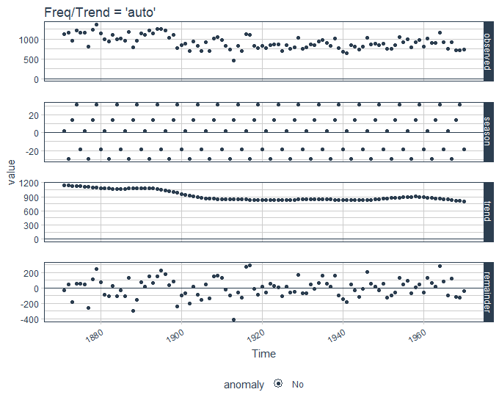
anomalize package
vs. tsoutliers
Notes:
Same Nile dataset

Slide 120
anomalize package
Pros:
Straightforward and fast timeseries decomposition
Cons:
Only AO
LS and TC can not be specified
Not backed by decent theory
Notes:
Zou best

Slide 121
gwloggeR
Feedback?

Slide 122
Next steps

Slide 123
Next steps
Define control vocabulary?
Suggested function output:
?
Notes:
temporal change : multiple points after the change should be “red”
Level shifts: how to flag those?

Slide 124
Next steps
Go further with tsoutliers
Visualisation: level shift (LS)
Simulations
Give a better idea of model performance for specific cases
Examples:
ARIMA(0,0,0) with AO
ARIMA(0,0,0) with LS
etc.
gwloggeR versioning?
Notes:
temporal change : multiple points after the change should be “red”
Level shifts: how to flag those?

Slide 125
The End

Slide 126
Sprint 1
Outliers

Slide 127
Outliers
v0.01: detect_outliers(data)
Uses only the supplied dataset
v0.02: detect_outliers(data, type = c(“air pressure”, “air temperature”), units)
Uses simple a-priori knowledge about air pressure, temperature, etc.
v0.03: …

Slide 128
Outliers: v0.01
Uses only the supplied dataset

Slide 129
Outliers: v0.01
Validation

Slide 130
Outliers: v0.01
Validation

Slide 131
Outliers: v0.01
Validation

Slide 132
Outliers: v0.01
Validation

Slide 133
Outliers: v0.01
Validation

Slide 134
Outliers: v0.01
Validation

Slide 135
Outliers: v0.01
Validation

Slide 136
Outliers: v0.01
Validation
Scale completely wrong?

Slide 137
Outliers: v0.02
Uses simple a-priori knowledge about air pressure, temperature, etc.

Slide 138
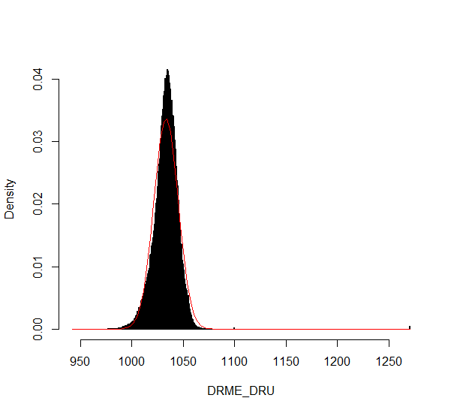
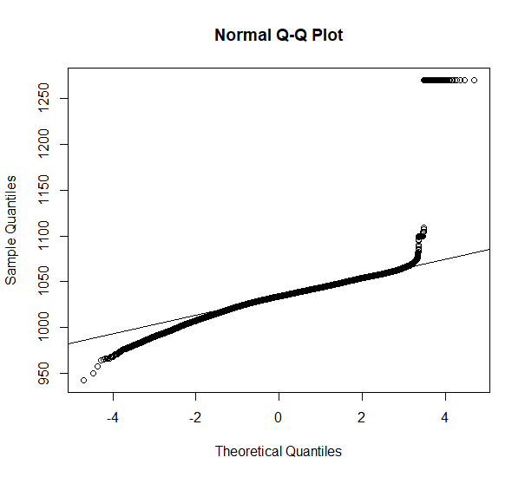
Outliers: v0.02
Validation

Slide 139
Outliers: v0.02
Validation

Slide 140
Outliers: v0.02
Validation

Slide 141
Outliers: v0.02
Validation

Slide 142
Summary
Outliers: v0.01
detect_outliers(data)
Usable on any data (not only L - lucht)
Scale can be completely wrong (cf. BAOL018X_42112)
Outliers: v0.02:
detect_outliers(data, type = c(“air pressure”, “air temperature”), units)
Needs a-priori information
Type
Units
Fixed or dynamic thresholds?
Notes:
Tresholds voor outliers kunnen berekend worden op basis van handmatige prior analyse, of

Slide 143
Outliers: v0.03
Go even further with a-priori information?

Slide 144
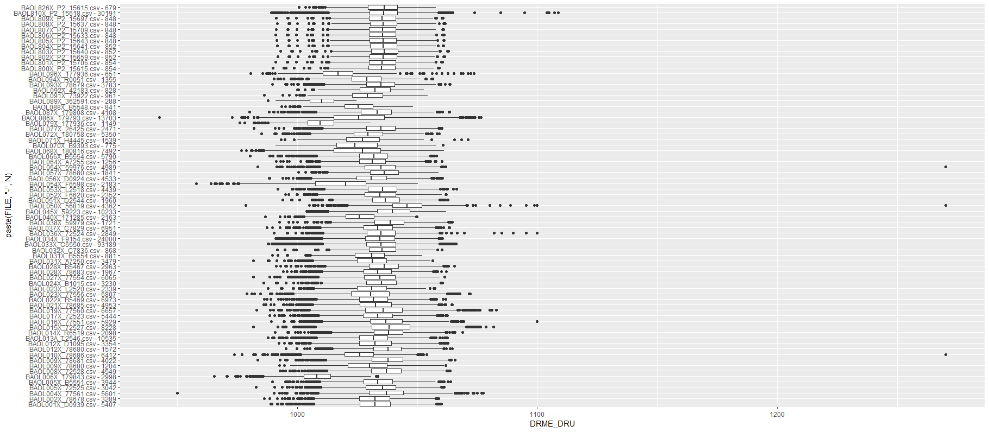
Outliers: v0.03
Even more a-priori information to explain variation
Notes:
Bijvoorbeeld, somige regio’s hebben lagere of hogere temperature, wat resulteert in hogere of lagere luchtdruk.

Slide 145
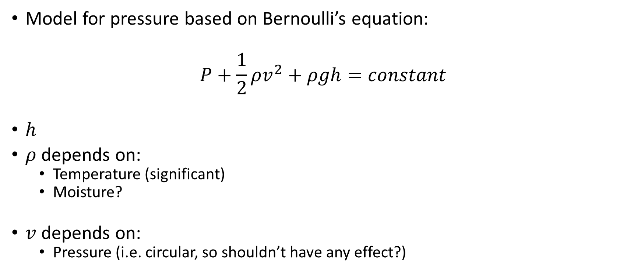
Outliers: v0.03
Model for pressure based on Bernoulli’s equation:
$$P+\frac{1}{2}ρv^{2}+ρgh=constant$$
$h$
$ρ$ depends on:
Temperature (significant)
Moisture?
$v$ depends on:
Pressure (i.e. circular, so shouldn’t have any effect?)

Slide 146
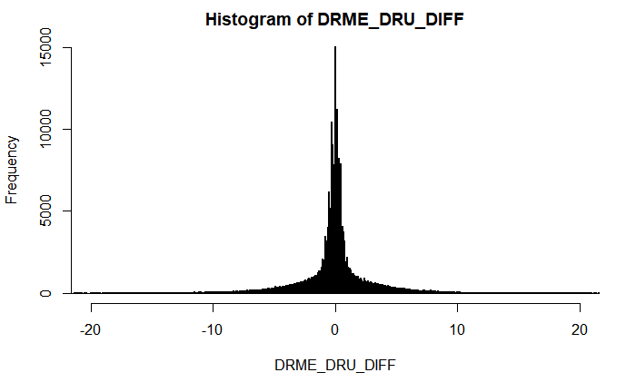
Outliers: v???
First order difference: very long tails
Notes:
Very long tails, not normal

Slide 147
Next steps

Slide 148
Next steps
Make first version of package with outlier detector 0.01 and 0.02?
If no extra data supplied, use v0.01, else v0.02?
v0.02: fixed or dynamic thresholds?
Other ideas?
Notes:
Misschien best om zo snel mogelijk met package te beginnen: dan kan gebruik meteen geevalueerd worden.

Slide 149
The End

